Slide 1
Trading Utilization for Circuitry: Hardware-Software Co-design for Real-Time Software-Based Short-Circuit Protection
Aaron Willcock
Department of Computer Science, Wayne State University, USA

Slide 2
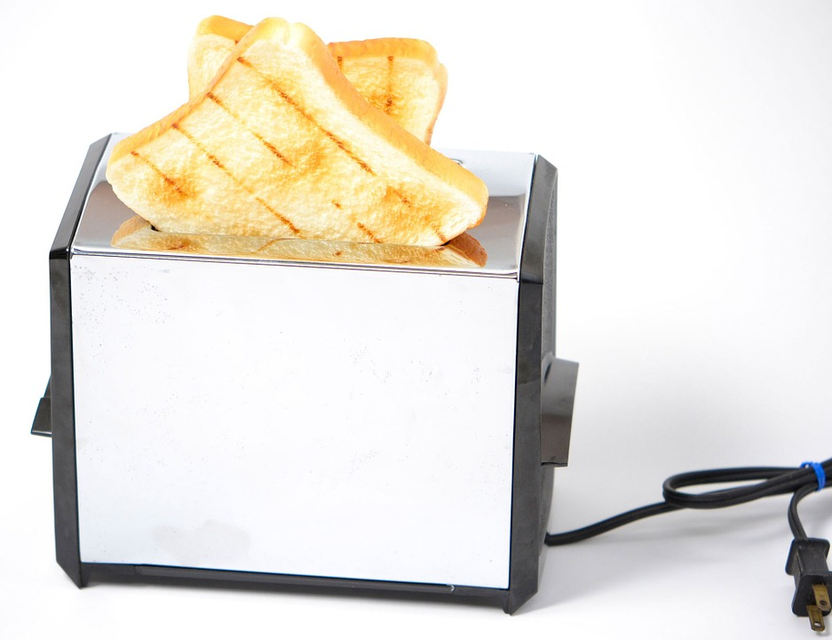



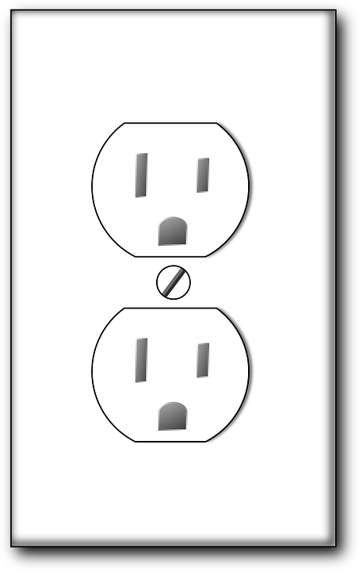
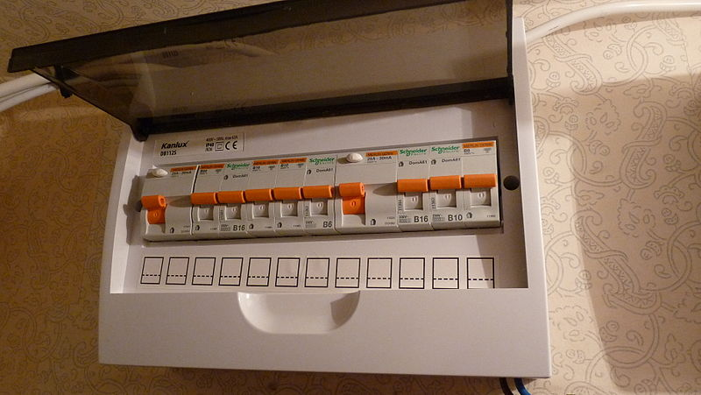
Toast, anyone?
?
?
Notes:
Have you ever been tempted to toss a toaster into the tub?
Perhaps silverware in a socket is more your style?
You don’t have to admit it here. But if you found yourself considering it, know that there are safety mechanisms to stop the short circuits you’d create making it much less exciting.

Slide 3
Not Your Fault
Ground Fault Interrupter
Fuse Box
Image Provided by: Dimitry G https://commons.wikimedia.org/wiki/File:Fuse_box_after_finishing.JPG
Goal: Stop short circuits, avoid damage (death) via fixed hardware
Notes:
If your house or apartment was constructed more recently, it likely has Ground Fault Interrupters and Fuse Boxes aimed at stopping short circuits before they cause damage. These protection mechanisms, however, is fixed hardware. This is not the Internet of Things nor a SMART home feature.

Slide 4
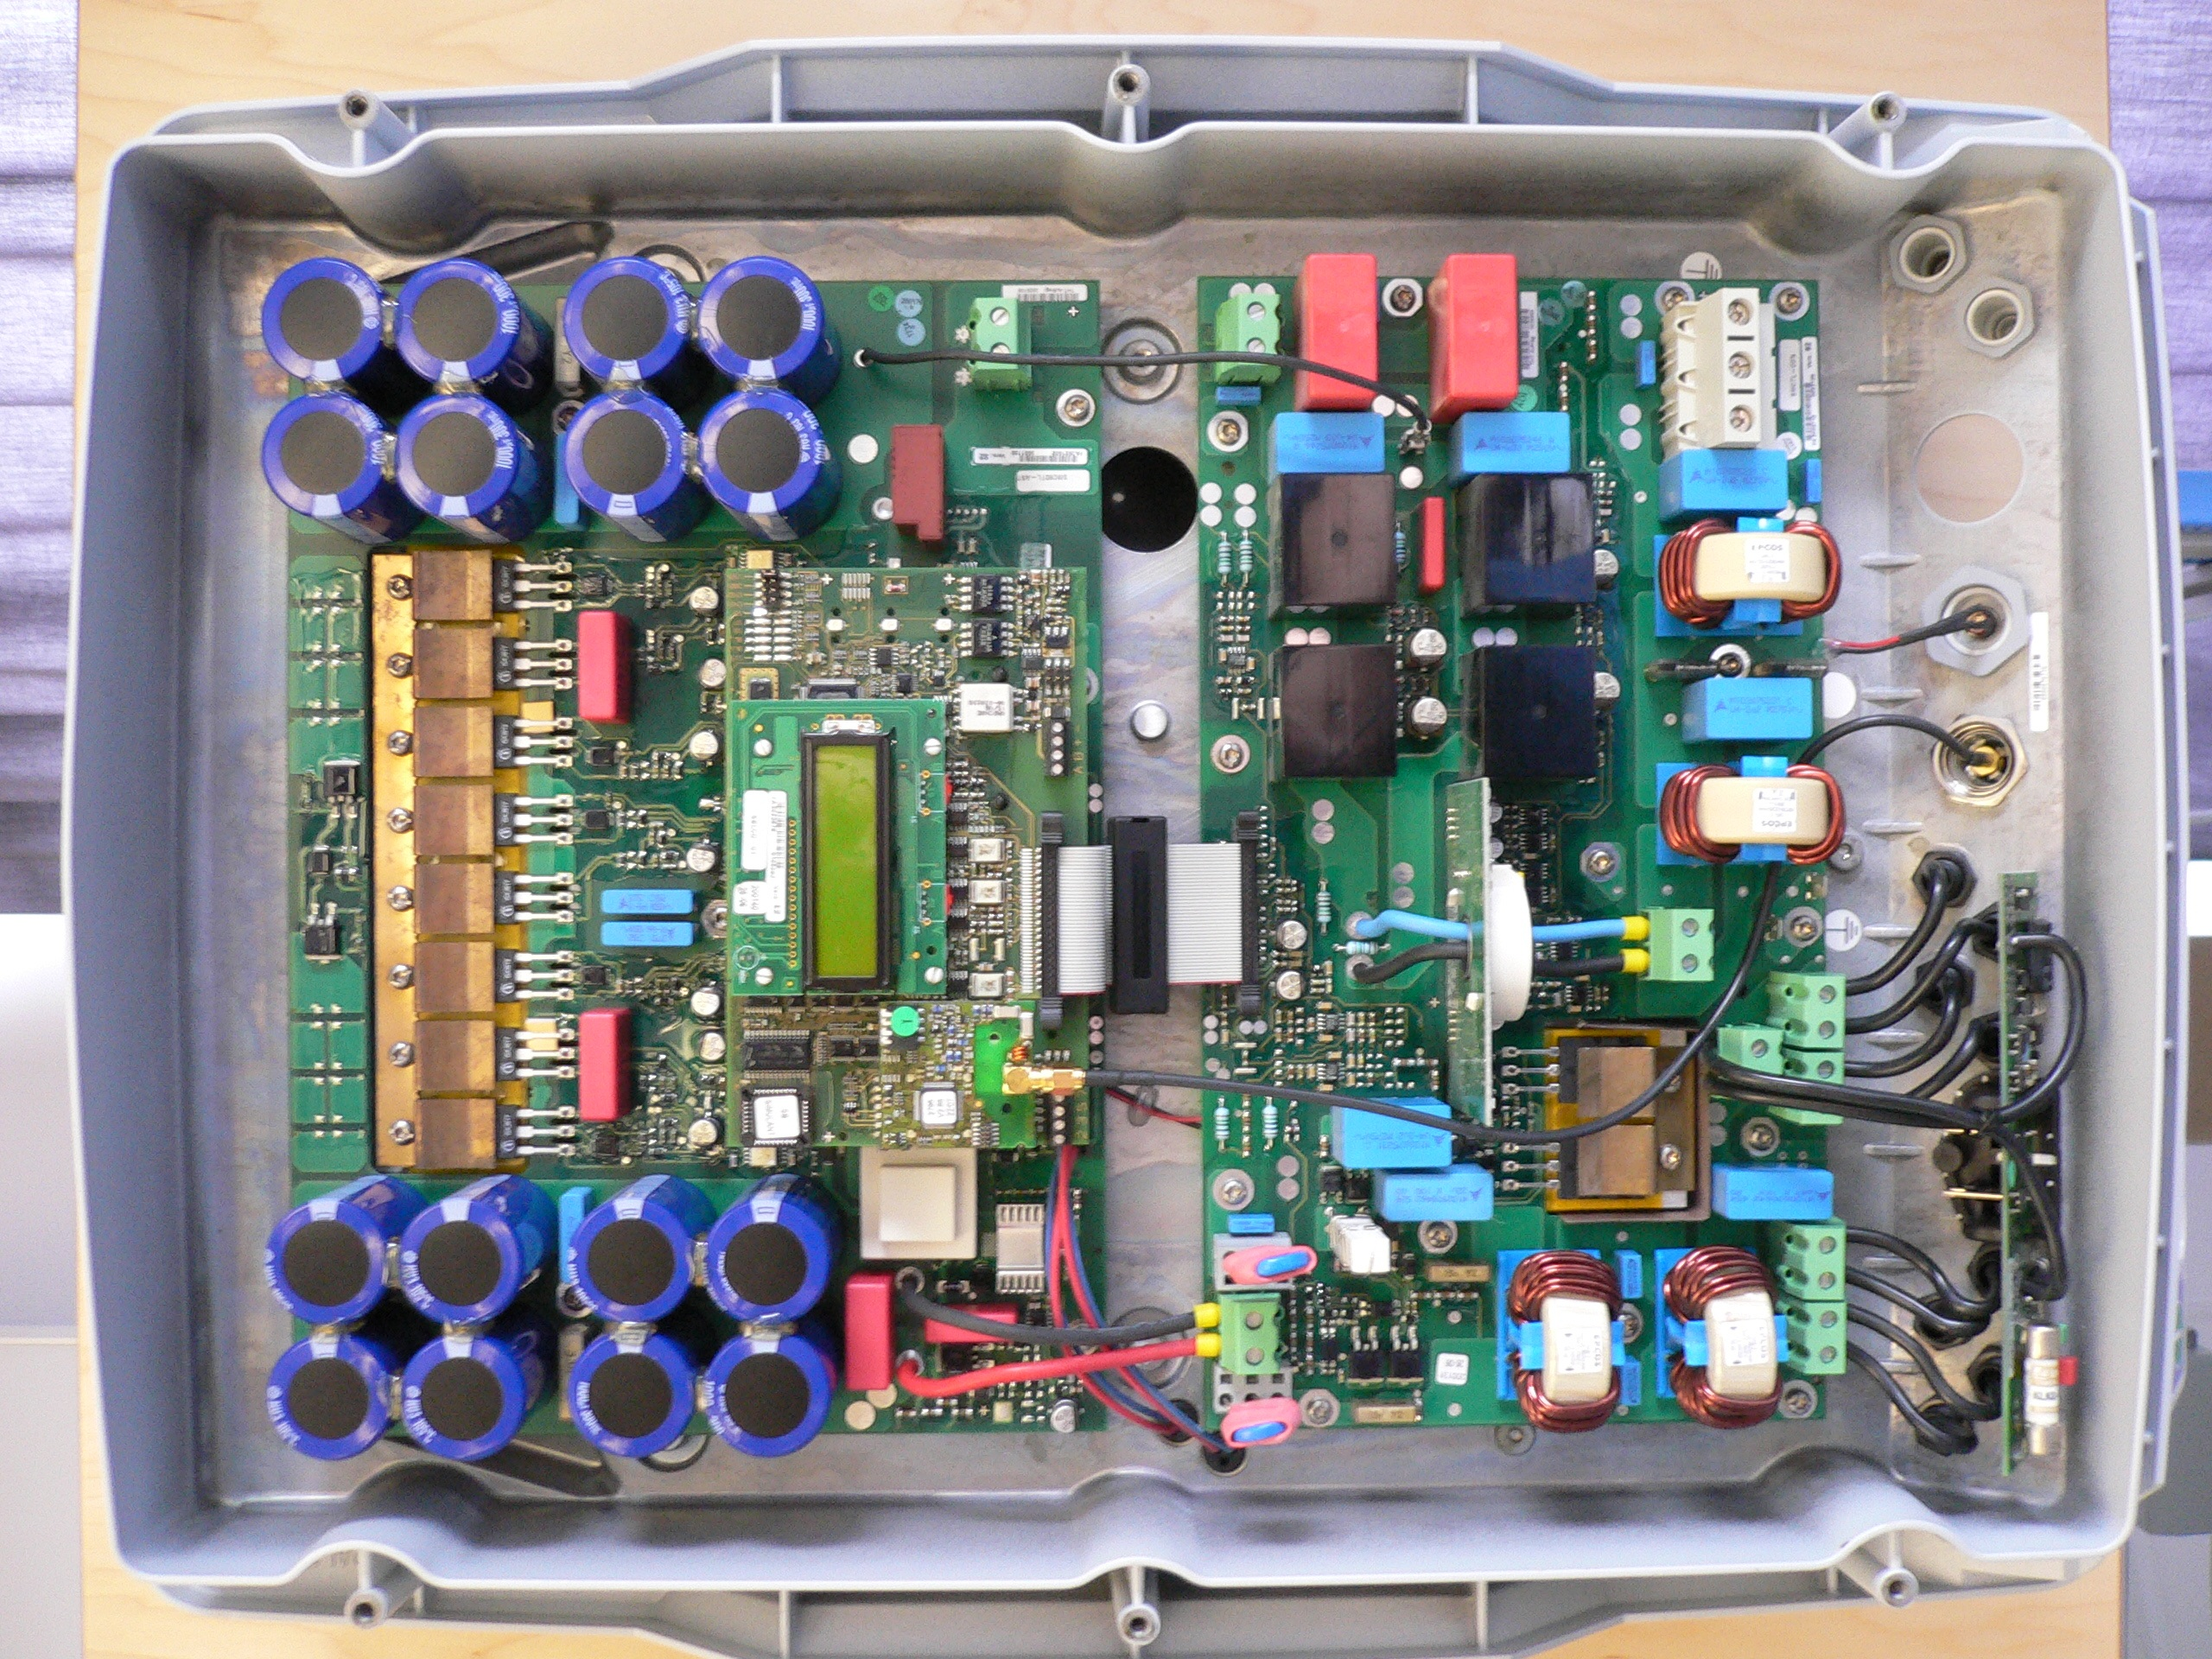
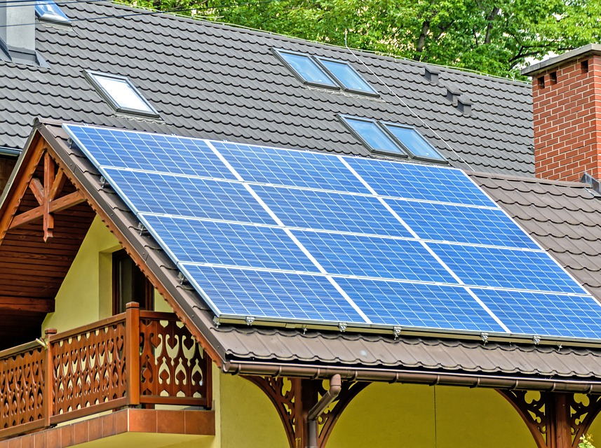
Your Home is Not Alone
Home Applications:
Photovoltaics
Industrial Electronics:
Devices using Insulated Gate Bipolar Transistors (IGBTs)
In General:
Power Converters / Inverters (AC → DC, DC → AC)
Notes:
But your home is not alone in this short-protection technology. Outside the house, photovoltaic systems require short protection as do industrial electronics like IGBTs. In general, systems that conduct power conversion have some short-circuit hardware in place to prevent damage and death.

Slide 5
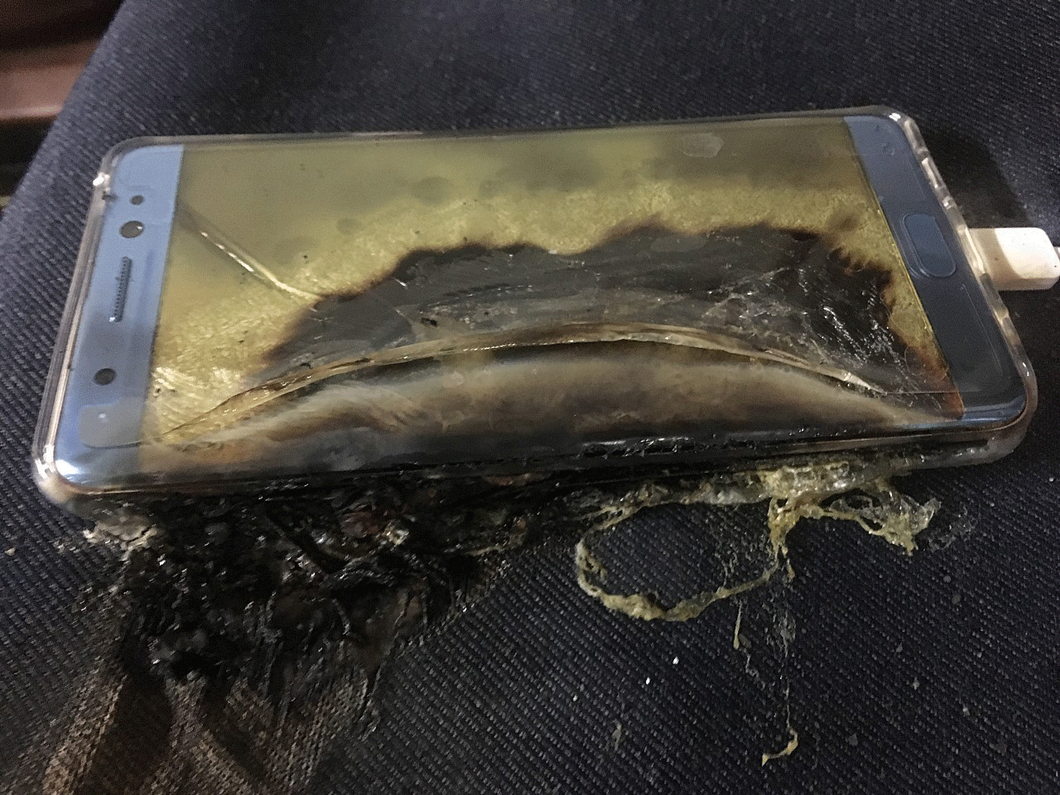
Low Power, High Stakes
Embedded systems need protection
Ex. Samsung Galaxy Note 7
Batteries caught fire
Device banned by FAA
Root cause: short circuits
Image Provided by: Independent.co.uk https://www.independent.co.uk/life-style/gadgets-and-tech/news/samsung-galaxy-note-7-return-refund-exploding-fire-brand-recall-a7361216.html
Notes:
Short circuits are not just a problem for houses. Embedded systems need protection as well! As an example, the Samsung galaxy note 7 made headlines when its batteries caught fire or exploded. The device was even banned by the FAA. After internal investigations, Samsung declared short circuits in the battery as the cause. Despite the lower power, short circuits can still cause substantial damage

Slide 6
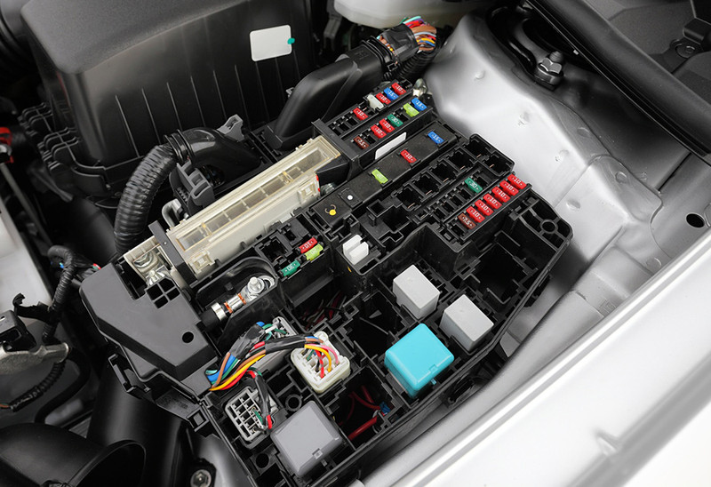
Motivation and Problem Statement
Short
Damage
Time-sensitive
Dedicated circuitry
Inflexible
Costly
Pessimistic
Problem Statement:
Existing short-circuit protection for embedded systems is fixed, inflexible and does not consider software-based real-time control.
Image Provided by: WEETECH Inc.
https://www.weetech-usa.com/applications/ automotive/relay-and-fuse-box/
Notes:
It’s well established that short circuits can cause damage and even death. What’s worse is that hardware-based approaches are inflexible, costly, and pessimistic. Consider automotive fuses for example. These fuses consume a great deal of space in a vehicle (and similarly in embedded platforms). When current through them is too high, it melts the metal connecting the two blades and the fuse breaks – cutting the power to the circuit in question. The problem is, the fuses must them be replaced. In an automobile this isn’t too problematic as these fuses are cheap but in an embedded system this can mean replacing the whole board. Furthermore, these systems are pessimistic because they can shut down entire networks within a board when only one component is at fault. As such, our problem…

Slide 7
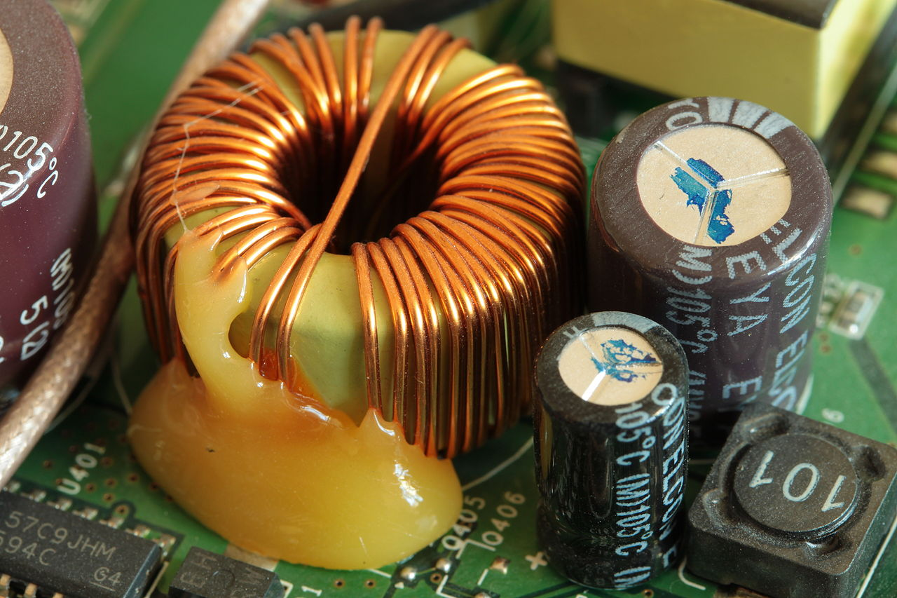
Approach
Inductor (slows the rise of current)
+
Real-time task (detects shorts by deadline)
=
Software-based real-time short-circuit protection
Main Idea
Leveraging physical dynamics can minimize pessimism in real-time systems
Notes:
To address this, our approach is to combine an inductor with a real-time task to detect and halt short circuits before they caused damage. An example inductor can be seen on the left (generally coils of copper wire). We’ve taken this approach with the goal of *MAIN IDEA* leveraging physical dynamics to minimize pessimism in real-time systems.

Slide 8
Contribution Summary
Real-time software-based short circuit protection method
Real-time utilization ↔ Board space consumed
Simulated and practical evaluation
Notes:
Our contributions therefore are a real-time software based short circuit protection method, a relationship between RT util and board space consumed by an inductor (as well as optimization approaches based on this relationship), and finally a simulated and practical evaluation of the proposed methods.

Slide 9
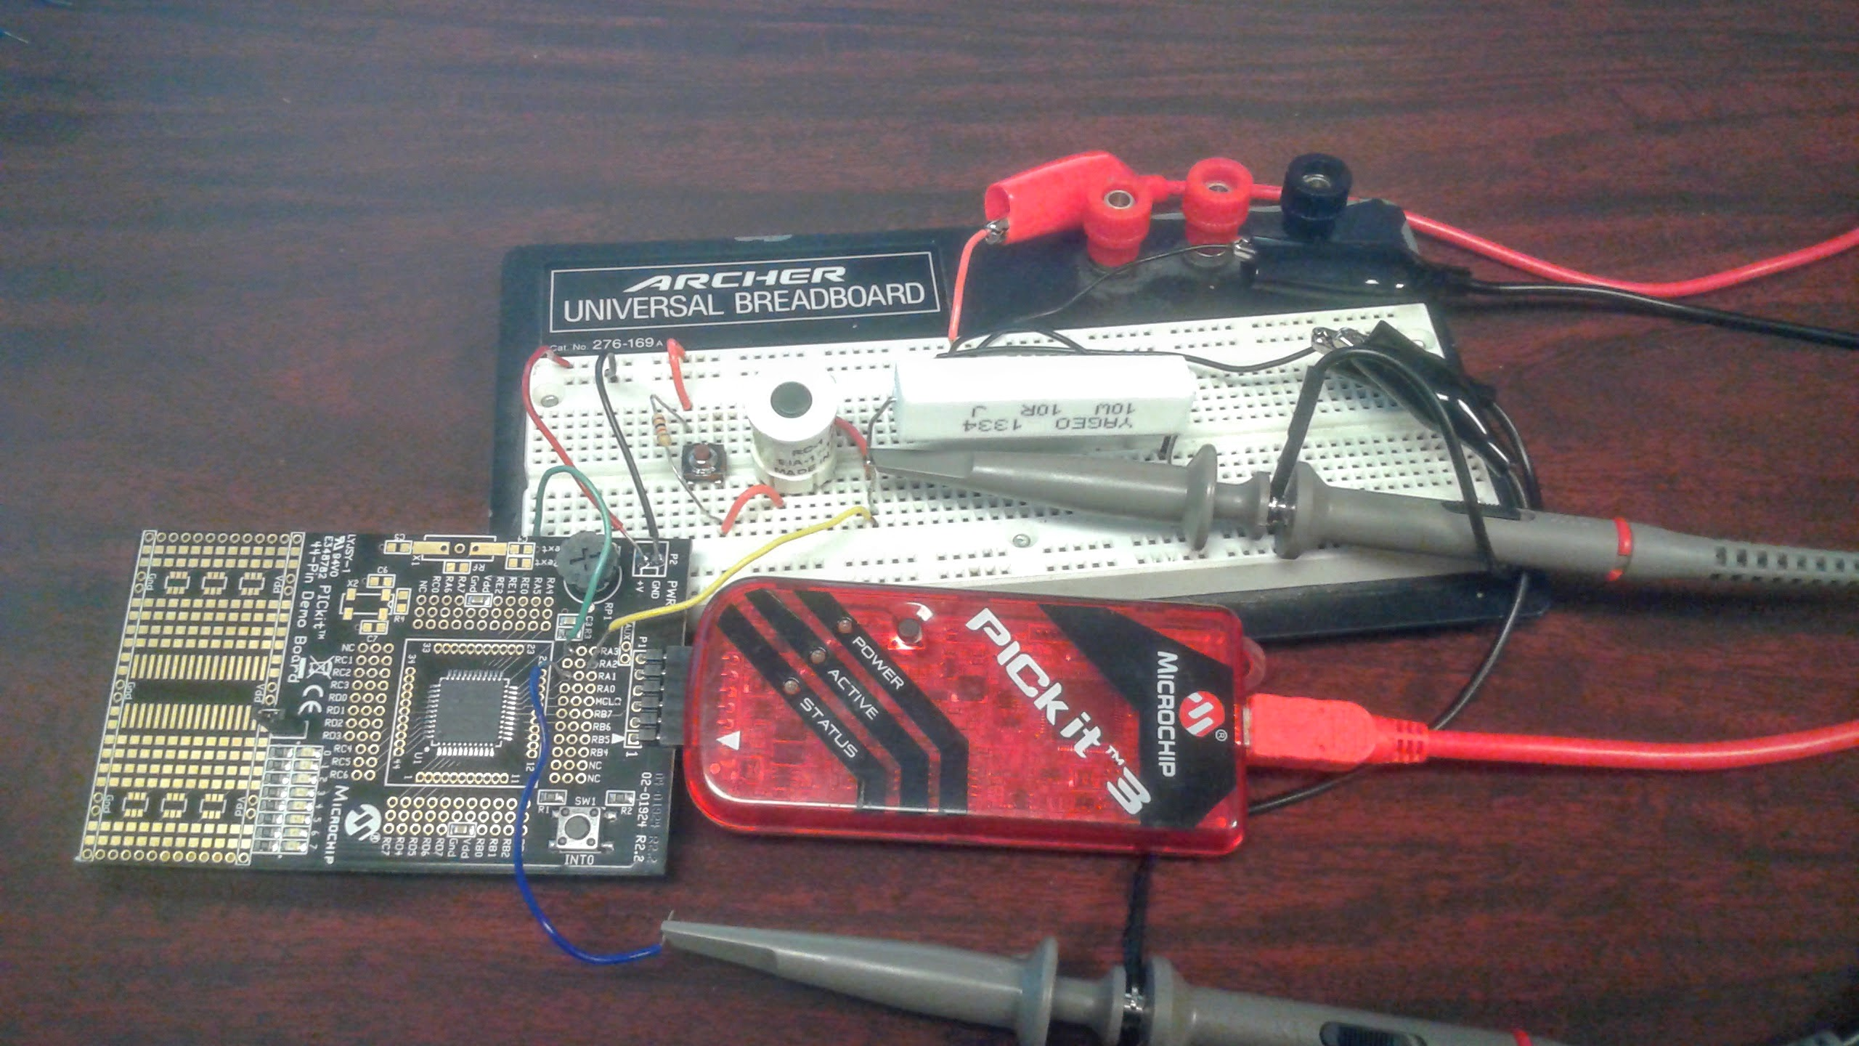
Outline
Electronics Background
Related Work
System Model
Evaluation and Results
Conclusion
Notes:
For the remainder of the presentation, I’ll cover a brief electronics background along with related works in both EE and RT, our proposed system model, evaluation, results, and some concluding notes.

Slide 10
Electronics Background

Slide 11

Basic Circuitry
Ohm’s Law:
V
=
I
R
Short The flow of current through an alternate, unintended path in a circuit with little or no impedance
I
Background
t
Notes:
As a quick review of basic circuitry, suppose we have a circuit with battery and load, a lightbulb. If we increase the load on the circuit …. Removing the load returns current flow to the nominal current and voltage. Furthermore, we can remove the initial load via a “short”

Slide 12
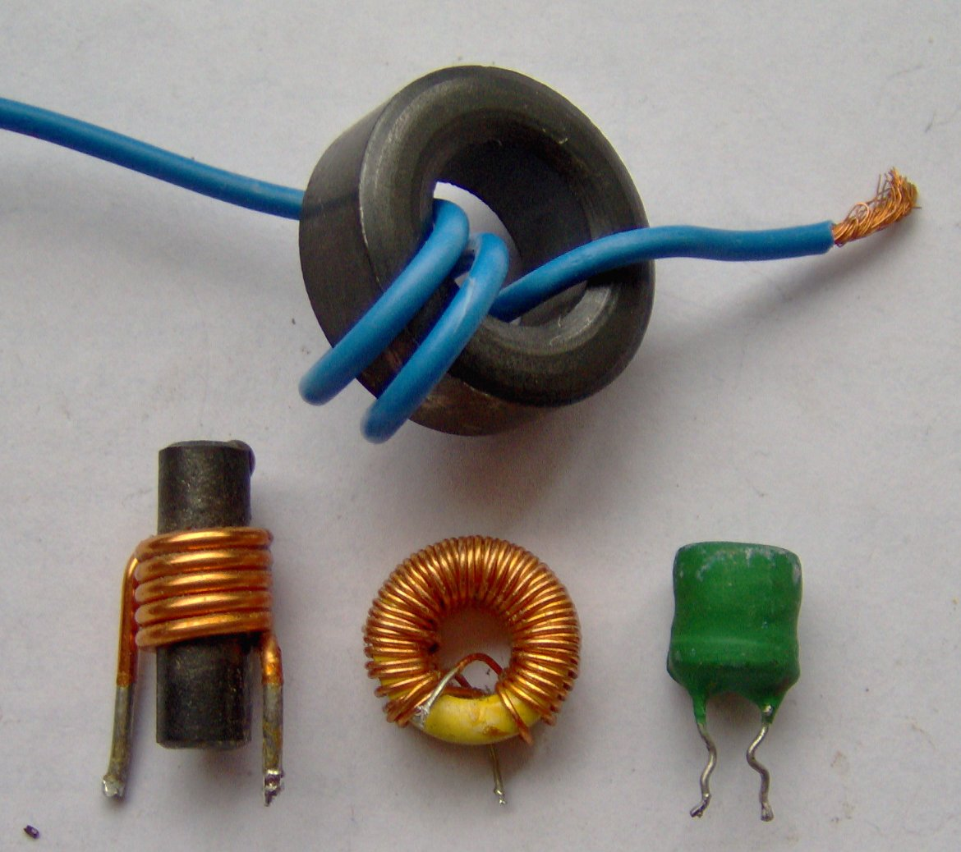

Inductors
Inductor Resists change in current
Schematic Symbol:
Term | Symbol | SI Unit
Inductance | L | Henry (H)
I
Background
Image Provided by: me - Photograph, CC BY-SA 3.0, https://commons.wikimedia.org/w/index.php?curid=1534586
t
Notes:
Most important chrematistic is its ability to resist changes in current.

Slide 13
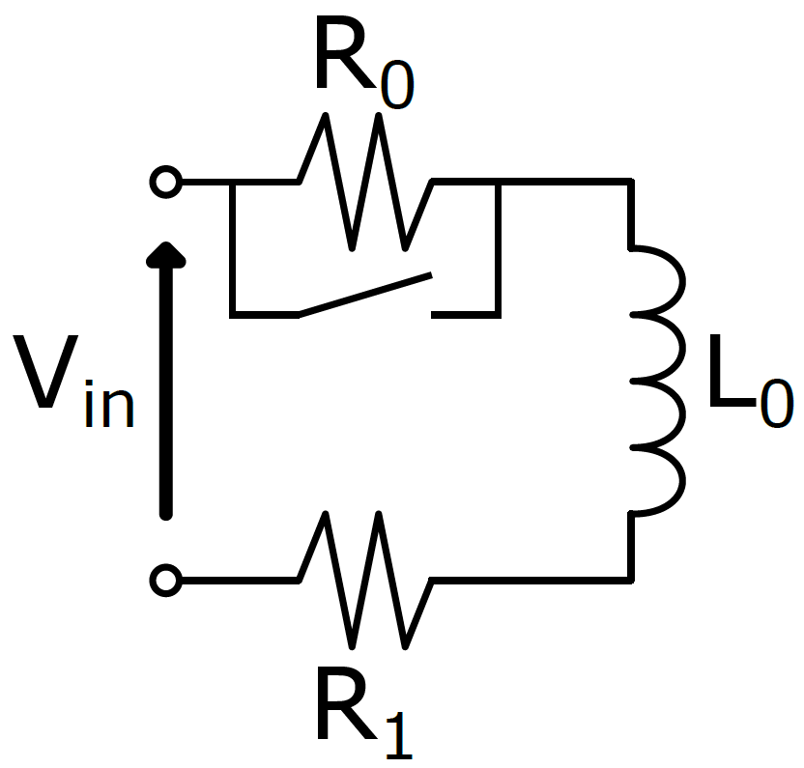
DC-RL Circuits
Direct Current (DC)
+
Resistor-Inductor (RL)
=
DC-RL
Background
Notes:
We can transform this example into the model we’ll use later: a DC-RL Circuit

Slide 14
Detailed Approach
Requires:
Inductor
Real-Time Task
Allows:
Short-circuit protection
Trading inductance (size) with task utilization
Approach

Slide 15
Related Work
Detection in Software
Detection in Hardware
Inductors
This Work
S. Hain and M. M. Bakran [6] Horiguchi et. al. [9] Wang et. al. [18]
No Inductors
?
Krone et. al. [13]
Related Work

Slide 16
System Model

Slide 17
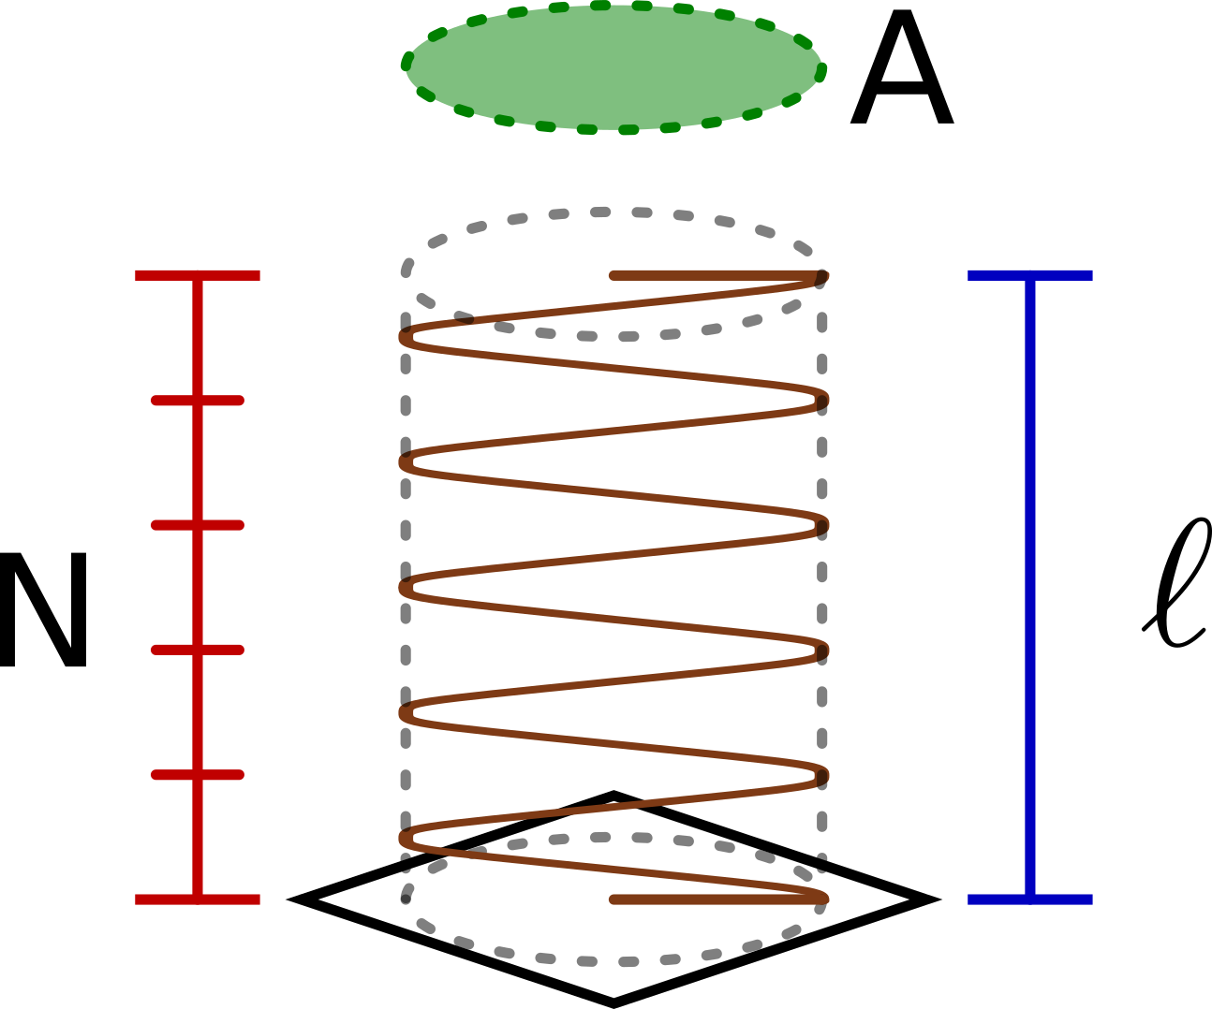
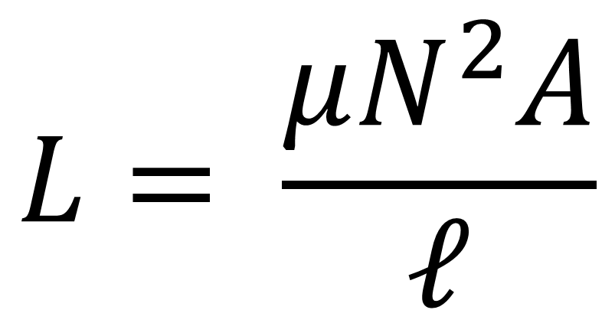
Inductors: Spatial Parameters
$$L= \frac{μN^{2}A}{ℓ}$$
Term | Symbol | SI Unit
Inductance | L | Henry (H)
System Model
Notes:
This is a spatial representation of a solenoid-style inductor (solenoid meaning a coil of wire that extends some length l).

Slide 18
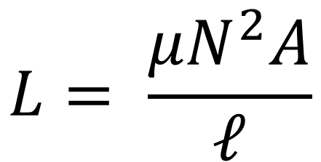
Quick Summary
$$L= \frac{μN^{2}A}{ℓ}$$
In practice, what do short-circuits with an inductor look like?
System Model
Notes:
As a quick review, we have a DC-RL circuit discussed earlier. It contains an inductor that we can model based on its spatial characteristics. So… what’s…

Slide 19
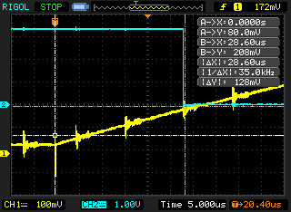
Electronics System: Example Short Detection
DetectionSignal
Voltage
Circuit Voltage
Time
System Model
Notes:
To answer that, let’s look at an example short detection.

Slide 20
Electronics System: Operating Current Model
Critical Current
Maximum Current
Operating Currents
System Model
Notes:
Some less obvious characteristics of this graph are the different modes the circuit can operate in. In our homes we use different loads at different times, but it’s important that your house be able to handle even the worst loads to be safe. We model our embedded system similarly.

Slide 21
Methods of Detection: Maximum I
Critical Current
Gap
Maximum Current
System Model
Notes:
Based on the OCM mentioned earlier, we can extract two methods for catching shorts. The most obvious is….

Slide 22
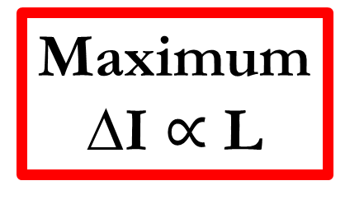
Methods of Detection: Maximum ∆I
Image Provided by: me - Photograph, CC BY-SA 3.0, https://commons.wikimedia.org/w/index.php?curid=1534586
Maximum ∆I $∝$ L
System Model
Notes:
A less obvious method of detection is using the maximum change in I. Slope of the line is proportional to inductance. Allows for detection long before even the maximum current is reached.

Slide 23
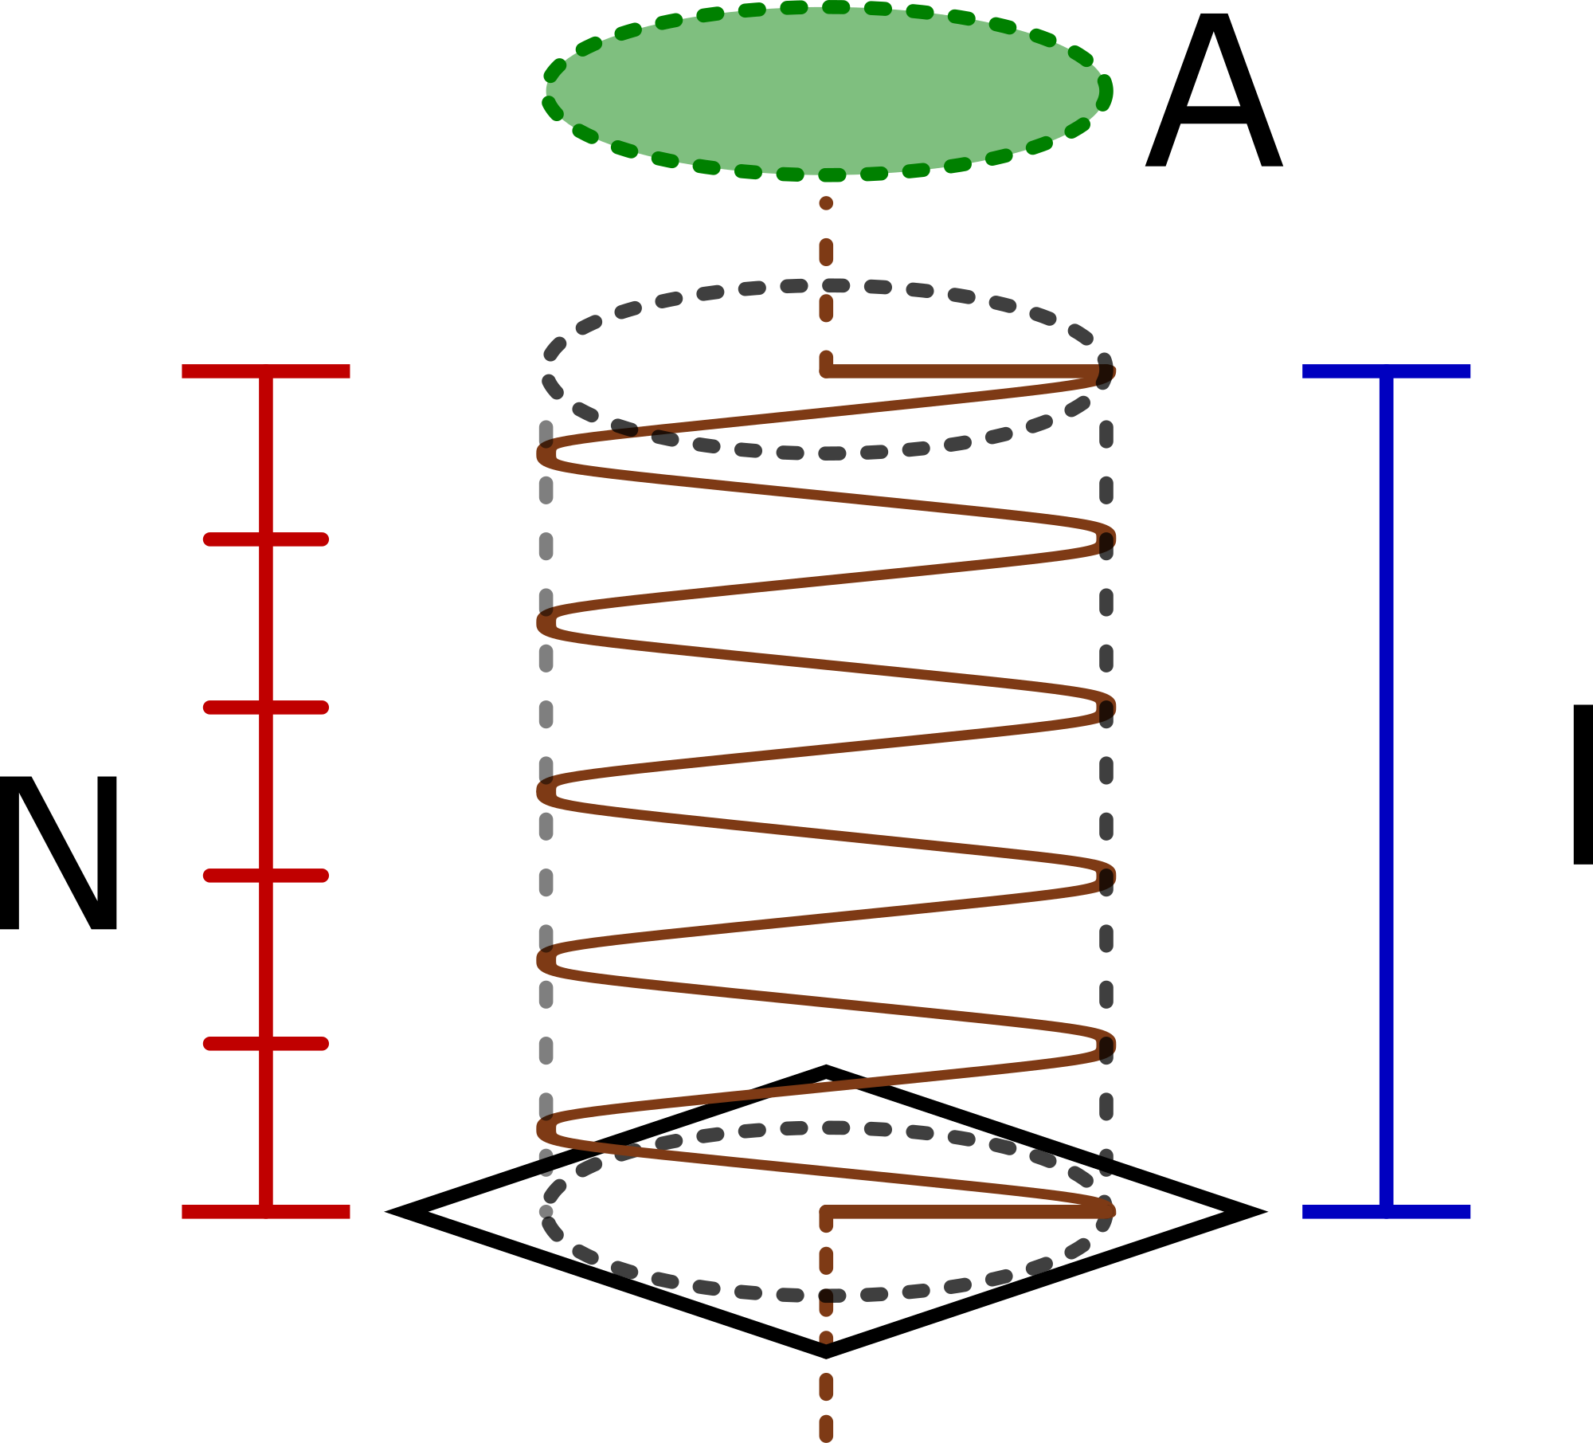
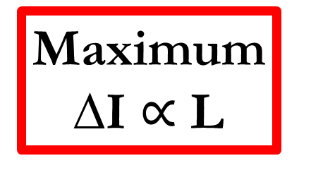
Quick Summary
Maximum Current
Max I Detection
Maximum ∆I $∝$ L
Max ∆I Detection
How much time do we have to catch a short-circuit?
System Model

Slide 24

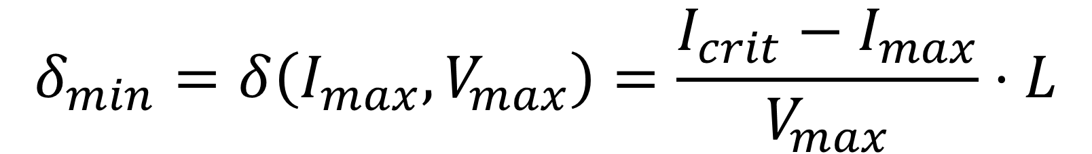

Methods of Detection: Min. Time to Detection
Crit. Current
Smallest Gap
$$÷$$
Maximum ∆I
$$=$$
Max. Current
$$δ_{min}=δ\left(I_{max},V_{max}\right)=\frac{I_{crit}−I_{max}}{V_{max}}⋅L$$
How do we translate this into a real-time task?
System Model
Notes:
To be effective and safe, our system must handle the worst case gracefully. This worst case comes when the smallest gap between maximum and critical currents is crossed using the maximum change in I allowed. To address this, we take the I_crit – I_max and divide by \Delta I giving us the fastest time a short circuit can cause damage and thus the maximum latency allowed for a successful short-detection.

Slide 25
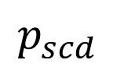
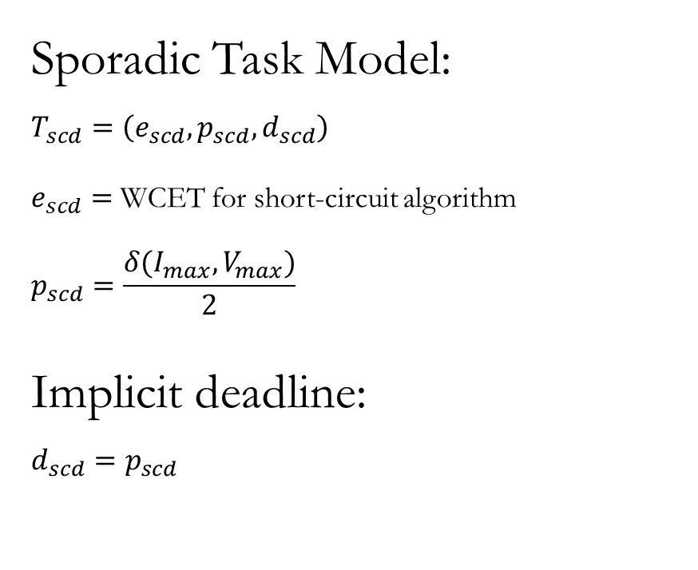



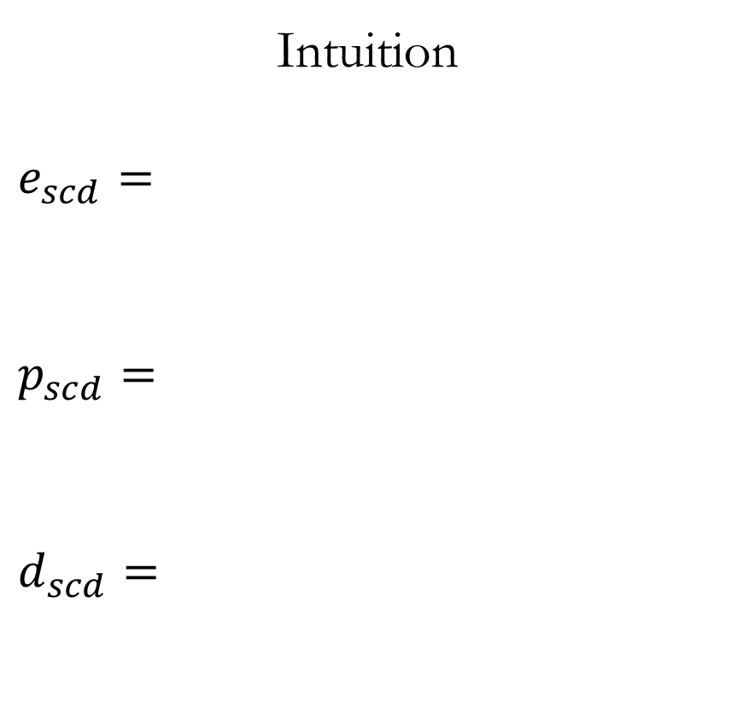
Real-Time System Model
Sporadic Task Model:
$$T_{scd}=\left(e_{scd},p_{scd},d_{scd}\right)$$ $e_{scd}=$ WCET for short-circuit algorithm
$$p_{scd}=\frac{δ(I_{max},V_{max})}{2}$$
Implicit deadline:
$$d_{scd}=p_{scd}$$
Intuition
$$e_{scd}=$$
$$p_{scd}=$$
$$d_{scd}=$$
Max I Detection
$$+$$
Max ∆I Detection
Smallest Gap
$$÷$$
Maximum ∆ I
$$2$$
$$p_{scd}$$
System Model
Notes:
We use a sporadic task model in which …
To illustrate the importance of this ½ term we’ll look at an unsuccessful detection schedule…

Slide 26
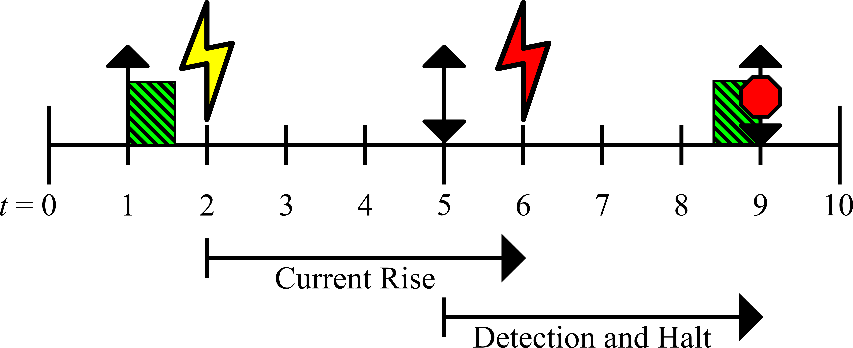
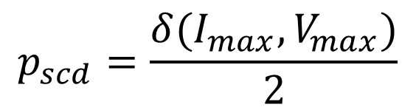
Real-Time System Model: Example Failure
$$p_{scd}=\frac{δ(I_{max},V_{max})}{2}$$
don’t divide by 2
Suppose period = δ = 4
System Model
Notes:
We miss the short detection because the maximum time between consecutive jobs exceeds the minimum time to detection.

Slide 27
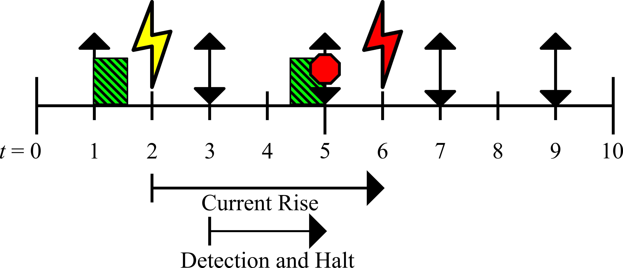
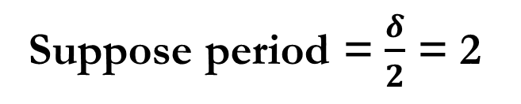
Real-Time System Model: Example Success
$$p_{scd}=\frac{δ(I_{max},V_{max})}{2}$$
do divide by 2
Suppose period = $\frac{δ}{2}$ = 2
System Model
Notes:
Dividing by two guarantees detection in time, even if the short occurs instantaneously before the release.

Slide 28
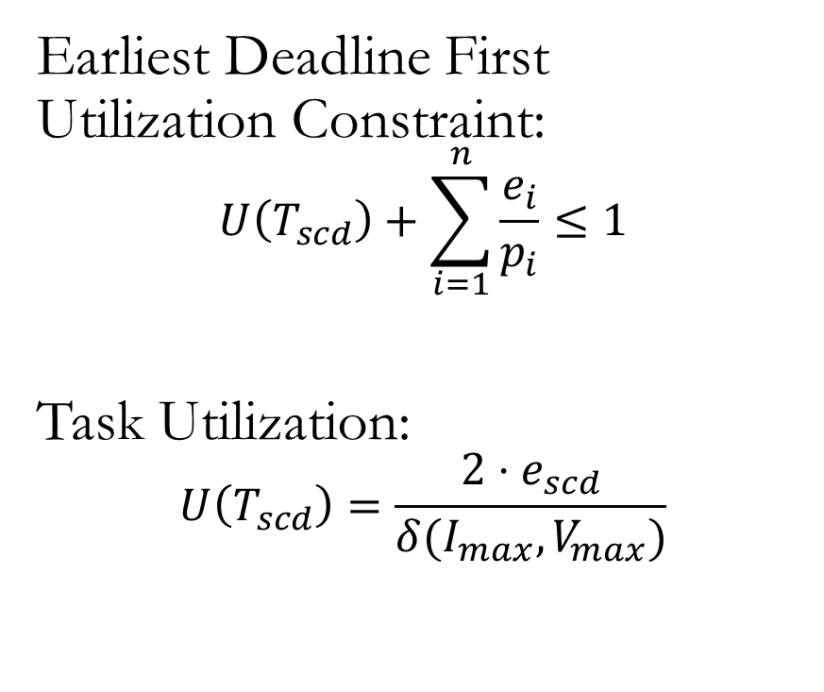
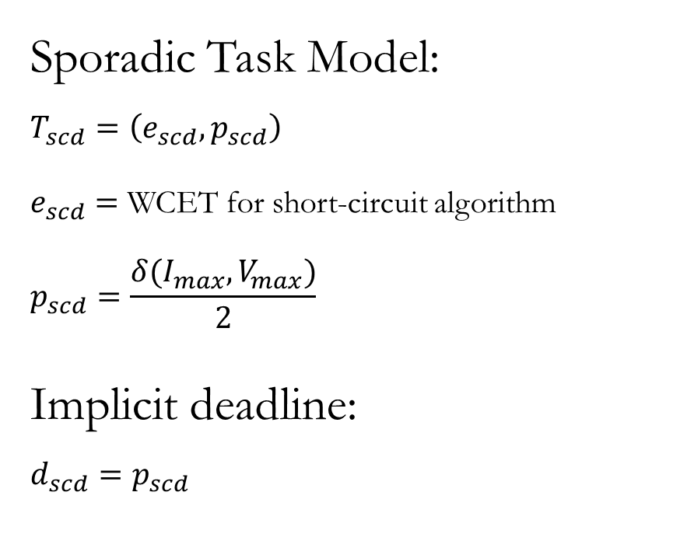
Real-Time System Model: Utilization
Sporadic Task Model:
$$T_{scd}=\left(e_{scd},p_{scd}\right)$$ $e_{scd}=$ WCET for short-circuit algorithm
$$p_{scd}=\frac{δ(I_{max},V_{max})}{2}$$
Implicit deadline:
$$d_{scd}=p_{scd}$$
Earliest Deadline First Utilization Constraint:
$$U\left(T_{scd}\right)+\sum_{i=1}^{n}{\frac{e_{i}}{p_{i}}}≤1$$
Task Utilization:
$$U\left(T_{scd}\right)=\frac{2⋅e_{scd}}{δ(I_{max},V_{max})}$$
System Model
Notes:
Some quick math gives us our task utilization where our execution time is divided by period.

Slide 29
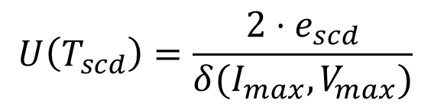

Quick Model Summary
Crit. Current
Min. Time to Detection
Max. Current
$$+$$
Maximum ∆I
$$U\left(T_{scd}\right)=\frac{2⋅e_{scd}}{δ(I_{max},V_{max})}$$
System Model

Slide 30
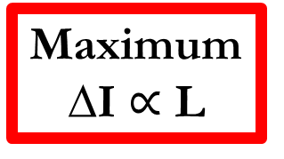
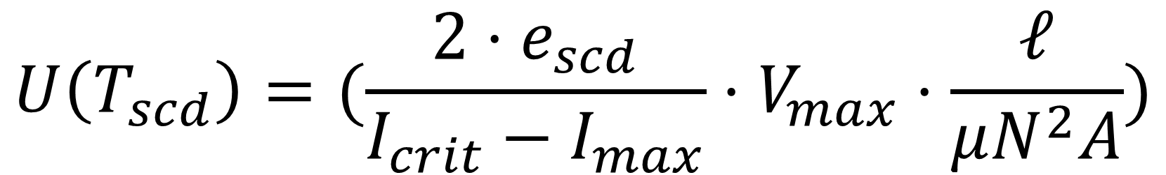
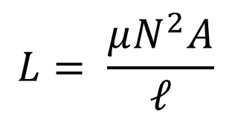
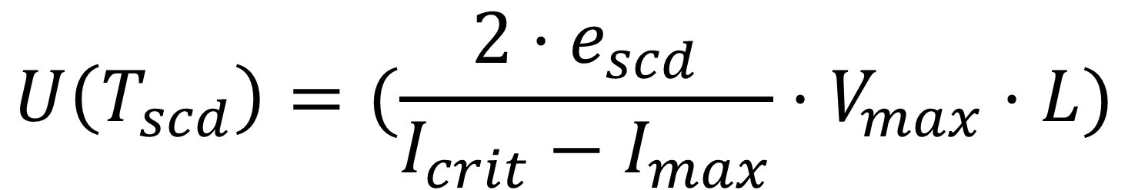
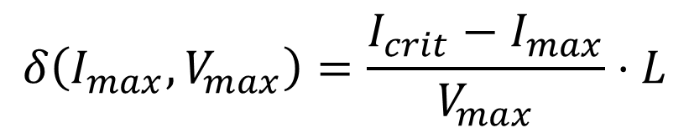
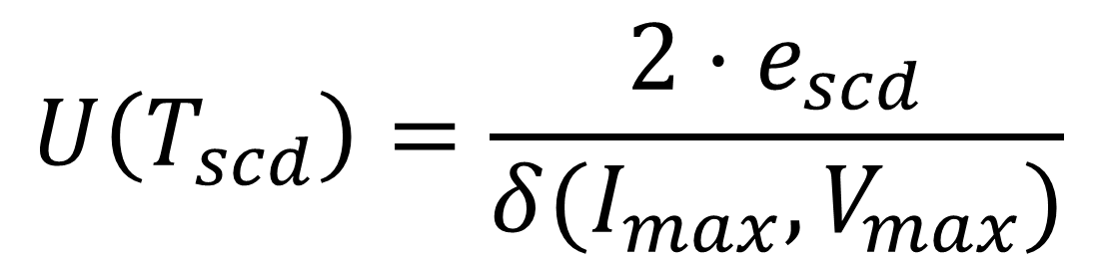
Inductance vs Utilization Relationship
$$U\left(T_{scd}\right)=\frac{2⋅e_{scd}}{δ(I_{max},V_{max})}$$
$$U\left(T_{scd}\right)=(\frac{2⋅e_{scd}}{I_{crit}−I_{max}}⋅V_{max}⋅\frac{ℓ}{μN^{2}A})$$
$$U\left(T_{scd}\right)=(\frac{2⋅e_{scd}}{I_{crit}−I_{max}}⋅V_{max}⋅L)$$
Primary Contribution:
$$L= \frac{μN^{2}A}{ℓ}$$
$$δ\left(I_{max},V_{max}\right)=\frac{I_{crit}−I_{max}}{V_{max}}⋅L$$
Maximum ∆I $∝$ L
Short-circuit task utilization may be traded with inductor size and thus board space consumed
System Model
Notes:
The primary contribution now comes from combining these previously distinct areas of hardware and scheduling to build a fluid relationship.

Slide 31
Evaluation and Results

Slide 32
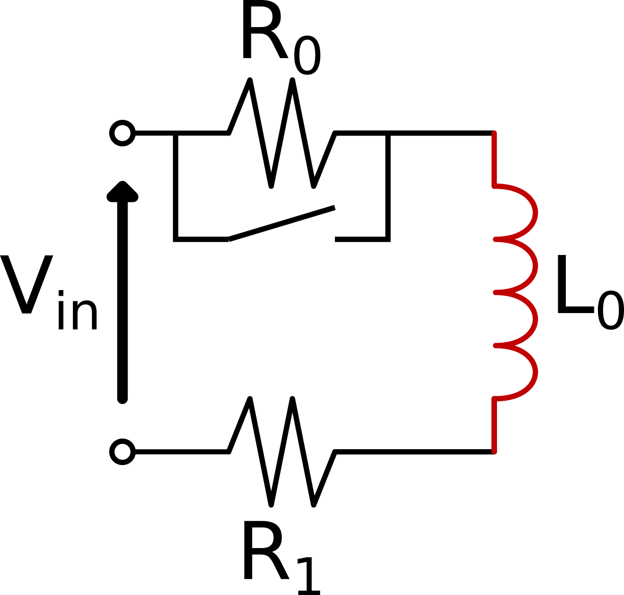
Experiment Setup
Processor: PIC18F45K20 Speed: 64MHz ADC: 10-bit
Evaluation

Slide 33
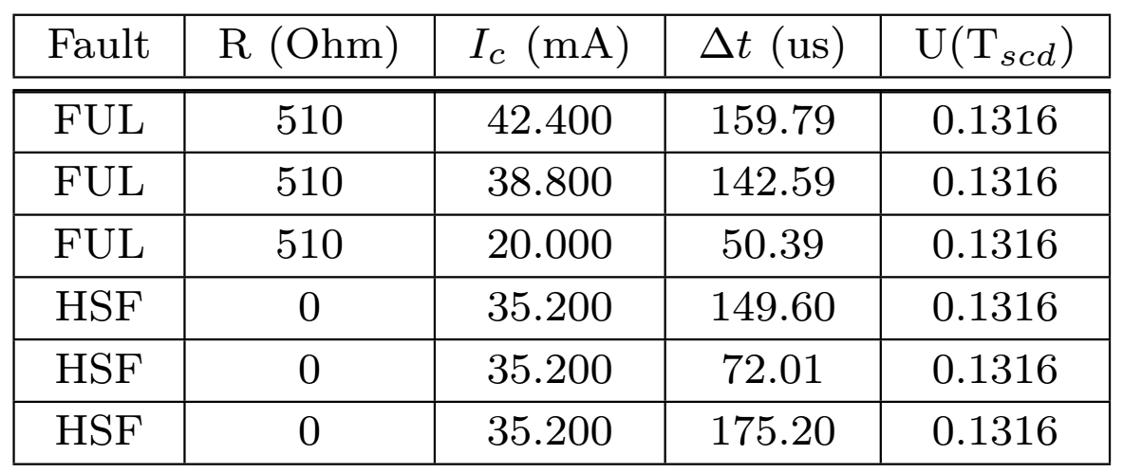
Experimentation: FUL and HSF Shorts
Experiment 1 : Fault Under Load (FUL); Experiment 2 : Hard-Switching Fault (HSF)
Critical current is 150 mA
Evaluation
Notes:
Here are the results of our experimentation. Note that the current at the time of detection is well below the allowed limit and our utilization is nearly 10%. No smaller utilization was allowed.

Slide 34
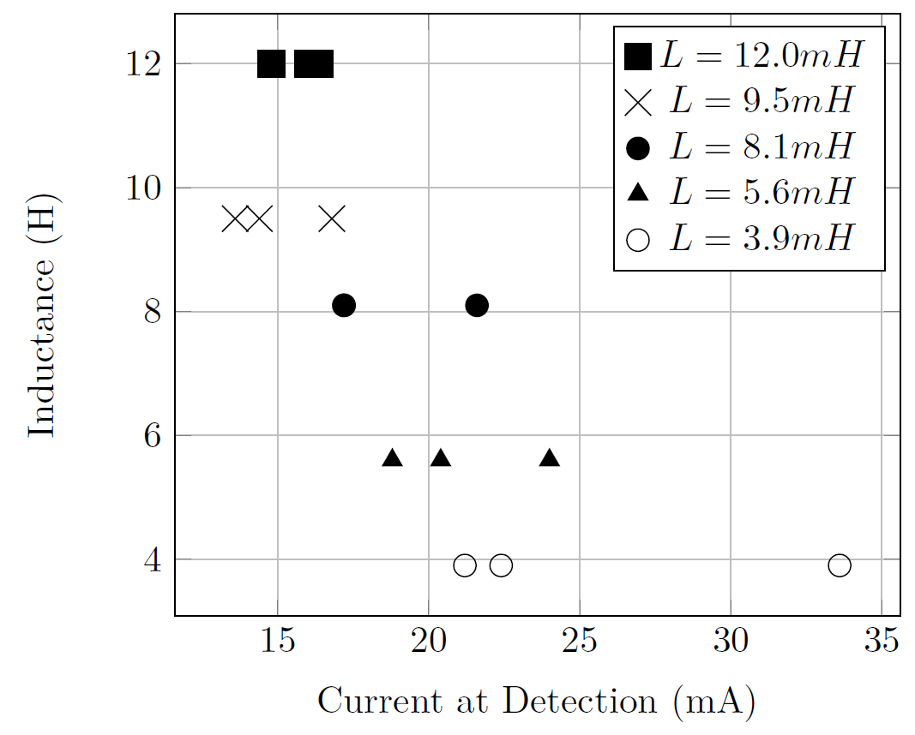
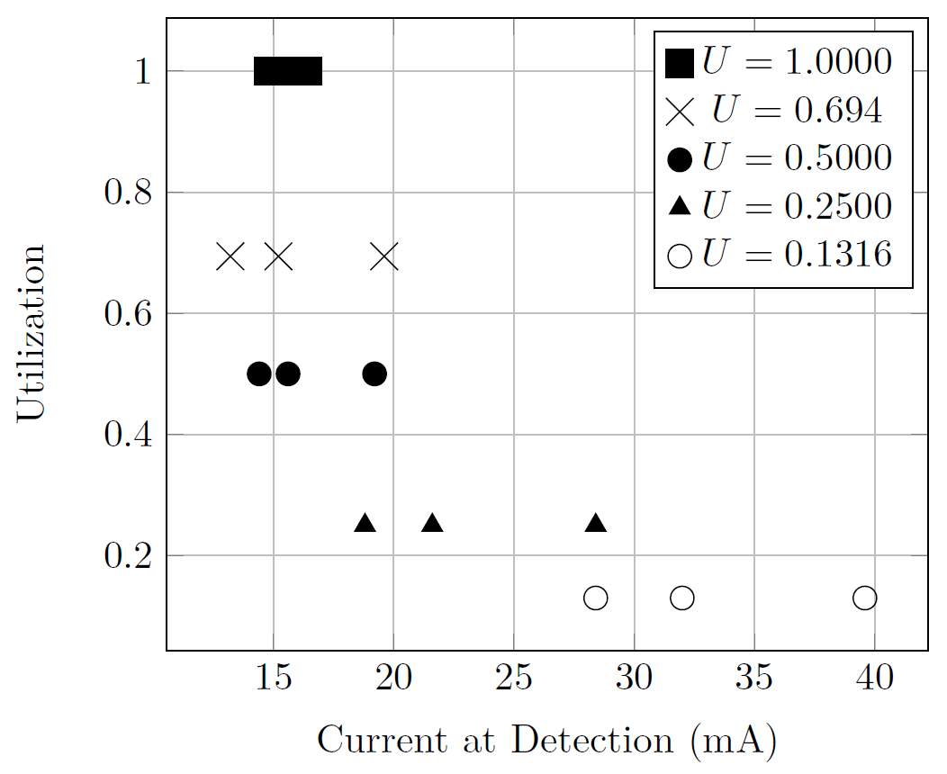
Experimentation: Scaling
Smaller utilization
=
larger current at time of detection
Smaller inductance
= larger current at time of detection
Evaluation
Notes:
Plotting the results of our experiments, we see two correlations are established. Together, these correlations establish that an increase in utilization is complemented with a decrease in inductance and vice versa.

Slide 35
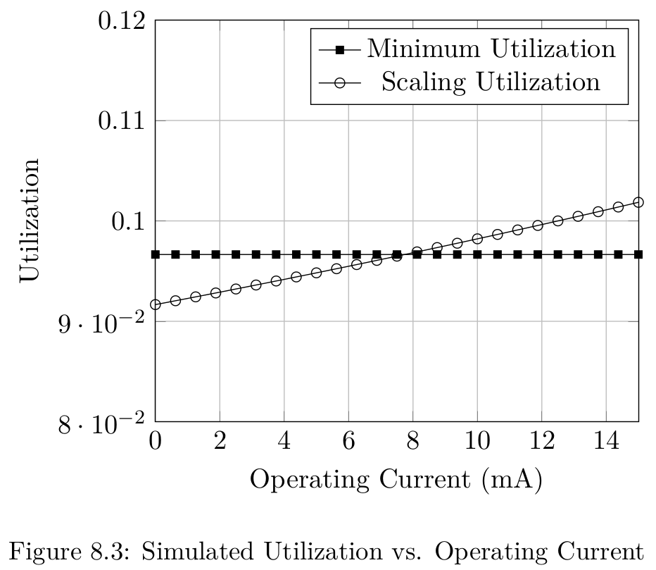
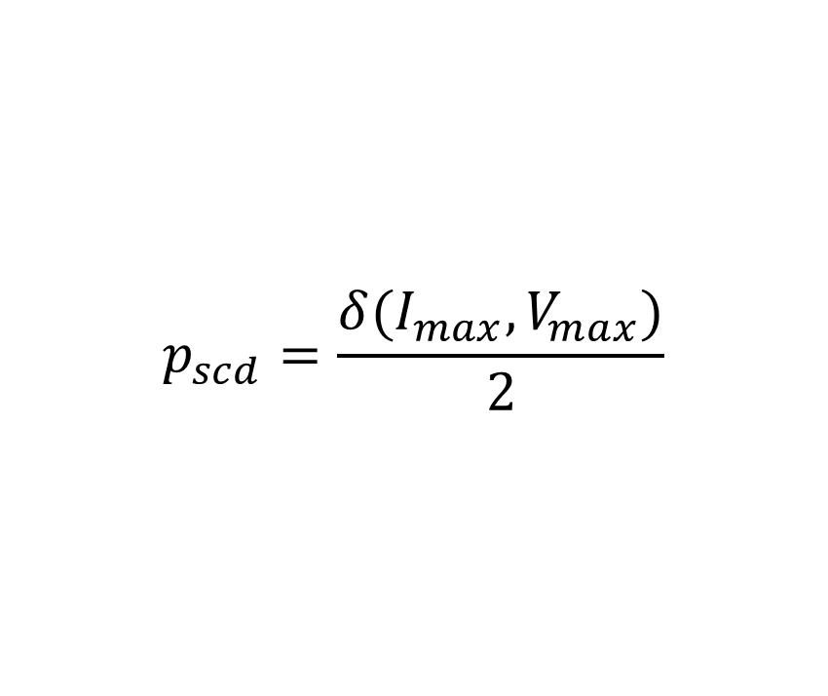
Short Detection with Varied Period
$$p_{scd}=\frac{δ(I_{max},V_{max})}{2}$$
Main Idea
Leveraging physical dynamics can minimize pessimism in real-time systems
Evaluation
Notes:
We also demonstrate that short detection can occur with a varied period, especially if the circuit experiences changes in power input it may adjust accordingly thereby sampling only as frequently as necessary based on input. So when no power is running, minimal sampling is needed.

Slide 36
Conclusion

Slide 37
Contribution Summary and Future Work
Contributions:
Real-time software-based short circuit protection method
Real-time utilization ↔ Board space consumed
Simulated and practical evaluation
Future Work:
Battery management
DC-RLC circuits (Resistor, Inductor, Capacitor)
Power consumption comparison
Conclusion

Slide 38
Previous Publication
Honors Sr. Thesis, Wayne State University, Detroit, USA. May 2016
Advisor: Prof. Nathan Fisher
23rd IEEE International Conference on Embedded and Real-Time Computing Systems and Applications, Hsinchu, Taiwan. Aug. 2017
Advisor: Prof. Nathan Fisher
Conclusion

Slide 39
Thank you!
Contributions:
Real-time software-based short circuit protection method
Real-time utilization ↔ Board space consumed
Simulated and practical evaluation
Future Work:
Battery management
DC-RLC circuits (Resistor, Inductor, Capacitor)
Power consumption comparison
Disclaimer: No toasters were harmed during this research.
Questions? aaron.willcock@wayne.edu
Conclusion

Slide 40
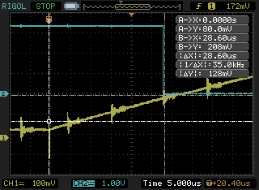

Slide 42
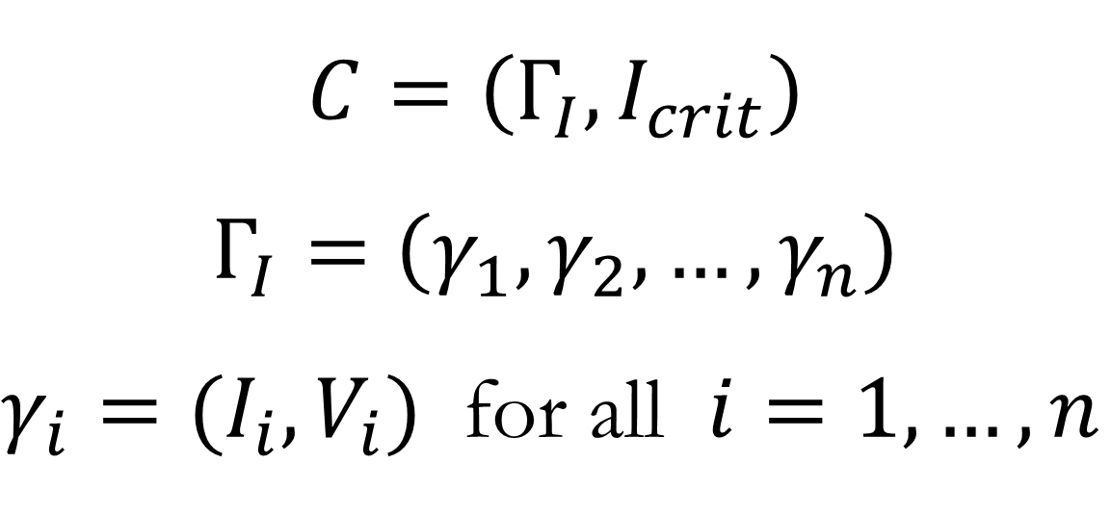
Electronics System: Operating Current Model
$$C=\left(Γ_{I},I_{crit}\right)$$
$$Γ_{I}=\left(γ_{1},γ_{2},…,γ_{n}\right)$$ $γ_{i}=(I_{i},V_{i})$ for all $i=1,…,n$
Critical Current
Maximum Current
Operating Currents
System Model
Notes:
Some less obvious characteristics of this graph are the different modes the circuit can operate in. In our homes we use different loads at different times, but it’s important that your house be able to handle even the worst loads to be safe. We model our embedded system similarly.

